Slide 1
Resource configuration, management and monitoring – at scale! - with PowerShell
Steve Roberts
Senior Technical Evangelist, Amazon Web Services
August 2019
Twitter: @bellevuesteve

Slide 2
In this session
Brief introduction to the AWS Tools for PowerShell
Scripting build-out and deployment to infrastructure on AWS
Management and monitoring
Sneak peek at … !
Notes:
Brief intro for those not familiar with the AWS modules and finding your way around
Resource management at scale requires consistent, repeatable automation
Script for standing up VPC network and fleet of EC2 Windows web servers, plus deployment
We’re not going to launch thousands of instances in this session, but what I’m showing is applicable whether you launch 1, 10, 100 or 1000’s or more!
Once at scale, we need to manage at scale
Looking at working with PowerShell and Systems Manager
Mention Andrew’s session on DSC later in the day
Sneak peek later at a proof of concept we’re thinking about

Slide 3
AWS Tools for PowerShell
Notes:
Aim to get everyone on same page regarding tools and exciting new development!

Slide 4
V1.0 shipped December 2012
Contained approx. 550 cmdlets across approx. 20 services
Latest version (v3.3.553.0, July 19th 2019)
5939 cmdlets across 175 services
Two modules
Windows PowerShell (v2+) – “AWSPowerShell”
PowerShell 6 (aka PowerShell Core) – “AWSPowerShell.NetCore”
100% compatibility between the two modules
Almost all cmdlets map 1:1 to AWS service APIs
Some ‘higher level’ cmdlets wrap multiple APIs (eg Write-S3Object)
If you can code it in an SDK, you can script it in PowerShell!
Notes:
Extensive support for AWS service APIs from PowerShell

Slide 5
Demo: Getting started with the tools
Notes:
First 5 mins:
How to install and configure credentials – gallery or msi
What services are supported?
What cmdlets are available for a service?
What cmdlet maps to a particular service API?
I have an AWS CLI command, what cmdlet does it map to?
Pre-installed on EC2 Windows and can get credentials/region automatically from instance metadata

Slide 6
Recap
Installation options
New tools preview on PowerShell Gallery!
per-service modules and mandatory parameter attribution
AWS.Tools.servicename module name pattern
Much, much faster to use!
Configuring credential profiles and region
How to determine supported services and cmdlets
How to map from service API ‘X’ to cmdlet
How to map from AWS CLI command to PowerShell cmdlet

Slide 7
Creating infrastructure
Infrastructure as code with the AWS Tools for PowerShell
Notes:
Back to resource construction at scale
As noted, we are looking for consistent, repeatable automation – console clicks from an operator won’t scale
So, why not script out what we need using the tools I just showed?

Slide 8
Building a web server fleet in a virtual private cloud (VPC)
Private subnets – one per AZ
Public subnets – one per Availability Zone (AZ)
Internet Gateway to allow inbound access from internet
Route tables and security groups for the public/private subnets
Auto Scaling group and launch configuration
Places EC2 instances (IIS web servers) into private subnets
Application Load Balancer routing traffic to instances from public subnets
NAT Gateway to allow outbound connectivity from instances
Notes:
We’re going to build a fleet of Windows web servers, secured inside a virtual private cloud
Web servers not directly addressable – all ingress traffic must come through load balancer
Servers do have outbound connectivity (for updates etc)
Servers are based on stock Amazon Windows images so will need to be configured on startup with IIS etc
Also want to simplify deployment so instances will be configured to use CodeDeploy

Slide 9








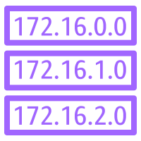


Example: creating a virtual private cloud (VPC) & IIS web server fleet
External client traffic connectivity
Web Browser (http)
Outbound-only connectivity (e.g. Windows Update)
Open internet
Local traffic
Region
VPC
Internet gateway
Availability Zone 1
Availability Zone 2
Availability Zone N
Public subnet
Elastic Load Balancing (ELB)
Public subnet
Public subnet
Security group
Security group
Security group
NAT gateway
…
Route table with IGW
Private subnet
Private subnet
Private subnet
Security group
Security group
Security group
Auto scaling group
IIS instance(s)
Route table w/out IGW
IIS instance(s)
IIS instance(s)
Notes:
Diagram illustrating the VPC and web server fleet our script builds - somewhat simplified to avoid clutter
Even for those not familiar with AWS and VPC networking, it’s a lot of resources and configuration!
Internet gateway allows in/outbound access to wider internet
NAT gateway (shared across subnets) permits outbound access – eg our IIS servers can get Windows Updates etc
ELB has a target group and listener setup to forward traffic to the instances in the private subnets – which do not have public IP addresses
We could have configured the auto scaling group to place instances into the public subnets. In this scenario however, I wanted to test using Systems Manager Session Manager to open PowerShell sessions onto EC2 instances that have no public IP – hence I placed them into private subnets with no direct connectivity from the open internet

Slide 10
Demo: Building infrastructure from script
Notes:
So, let’s go build!
Content in Demo1-EC2IISWebServerFleet subfolder
Uses simple ASP.NET demo app (which we’ll also use later) in Demo1App subfolder, configured as a webdeploy package

Slide 11
Recap
The range of cmdlets and supported services in the AWS modules means we can build almost anything from pure script!
We do need to be aware of eventual consistency
Not only can we build and configure infrastructure, we can also initiate deployments from PowerShell
Not just AWS CodeDeploy – can also initiate deployments to AWS Elastic Beanstalk
Notes:
Q: why not use CloudFormation (IAAS) and a declarative template?
Familiarity with PowerShell and perhaps service apis, not CloudFormation json/yaml
Need some imperative coding (loops, conditionals etc – hard to do in declarative format)
Elastic Beanstalk – PAAS service, you worry about the app and service worries about infrastructure
CodeDeploy is a bit closer to the ‘metal’

Slide 12
Managing and monitoring
PowerShell and AWS Systems Manager
Serverless PowerShell with AWS Lambda
Notes:
Once we have a fleet, no matter how small or large, we need to manage it
Again, console operator and a mouse won’t scale
Also might want to manage cloud and on-prem as a unified whole, what then?

Slide 13
What is AWS Systems Manager?
“Single pane of glass” oversight of your infrastructure
View operational data from multiple services
Seamlessly automate operational tasks across your resources
In cloud and on-prem
Simplified resource and application management
Easy to operate and manage your infrastructure securely at scale

Slide 14









AWS Systems Manager
Automation
Run command
Parameter Store
Maintenance windows
Documents
Inventory
Patch manager
State manager
+ Session Manager
Notes:
Systems Manager is a collection of services
- Automation: automate common and repetitive IT operations and management tasks across AWS resources, with scheduling support
- Run Command: remote management of your instances at scale without logging into your servers
- Patch Manager: select and deploy operating system and software patches automatically across large groups of EC2 or on-premises instances
- State Manager: configuration management, which helps you maintain consistent configuration of your EC2 or on-premises instances
Four ancillary services
- Parameter store: centralized store to manage your configuration data, whether plain-text data such as database strings or secrets such as passwords
- Maintenance windows: schedule windows of time to run administrative and maintenance tasks across your instances
- Inventory: collects information about your instances and the software installed on them
- Session Manager: browser-based interactive shell and CLI for managing Windows and Linux EC2 instances, no SSH or RDP ports need to be opened
The ‘document’ is at the heart of Systems Manager
And it’s all available from the AWS Tools for PowerShell and can use PowerShell too!

Slide 15
What is a ‘document’?
{
“schemaVersion”: “2.0”,
“description”: “Installs a Windows Feature”,
“parameters”: {
“feature”: {
“type”: “String”,
“description”: “Specify a package to install”
}
},
“mainSteps”: [ {
“action”: “aws:runPowerShellScript”,
“name”: “run”,
“inputs”: { “commands”: “Install-WindowsFeature {{feature}}” }
} ]
}
Notes:
A document contains metadata (schema, description), optional parameters plus the instructions to be run as a series of one or more steps – which can be PowerShell script

Slide 16
Demo: Management and monitoring
Notes:
Going to look at a number of features of Systems Manager
Parameter Store for reading and writing runtime configuration data
Run Command to execute Amazon-provided and custom scripts against a fleet (cloud & on-prem)
Session Manager for connecting to instances that have no direct connectivity – eg our web servers from demo1
With a fleet at scale, how can we monitor for issues? Going to look at serverless PowerShell for log monitoring

Slide 17
Recap
Using Parameter Store from our scripts/command line
Using Amazon-provided and custom Run Command documents
Using Session Manager to connect to instances
No need to open RDP or SSH ports!
Using serverless PowerShell to monitor deployed apps/infrastructure

Slide 18
Sneak peek!

Slide 19
The AWS Cloud Developer Kit (CDK)
Software development framework for defining cloud infrastructure in code and provisioning it through AWS CloudFormation
Programmatic (idiosyncratic) structured approach to organizing, composing, packaging and deploying applications and services
Organize components to create reusable cloud infrastructure
Sharable hierarchies and aggregations are encouraged
Infrastructure IN Code
In all AWS languages (eventually)
PowerShell, Java, C#, Python, JavaScript/Node.js, Golang, Ruby, PHP, C++
Notes:
CDK went GA at AWS NYC Summit in July 2019
.NET and Java support in preview but closing on release
CloudFormation accepts (largely) static, declarative templates in JSON or YAML
Can parameterize templates for some customization and re-use
Declarative templates can be awkward – eg creating multiple EC2 instances requires copy/paste, when we just want to loop 1..N (where N passed in as a parameter)
Ability to write code means we can take advantage of imperative coding – loops, branches, variables etc – and not be restricted by a largely static, declarative template
CDK takes your code and turns it onto a CloudFormation template
CLI commands to output template (if you care), deploy, diff etc

Slide 20
Structure of a CDK application
App
Environments
Stacks
Constructs
Resources
Notes:
From a code perspective, we write an app that is composed of one or more stacks
Each stack is composed of constructs which map down to one or more AWS resources

Slide 21










From CDK code to running infrastructure
CDK Application
Construct
Construct
cdk CLI
CloudFormation
Templates
AWS
CloudFormation
Notes:
You don’t need to see the template (unless you really care) but it is an option

Slide 22
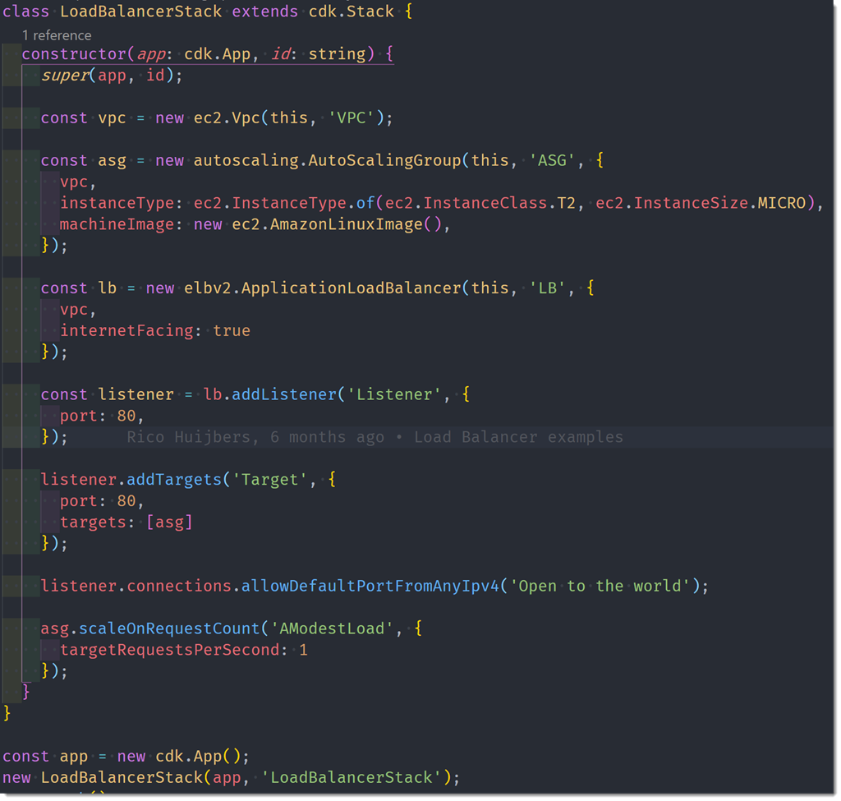
Typical CDK code (Typescript)
Notes:
One of the CDK examples to build an application load balancer with listener on port 80
The question is, what might this look like in PowerShell?

Slide 23
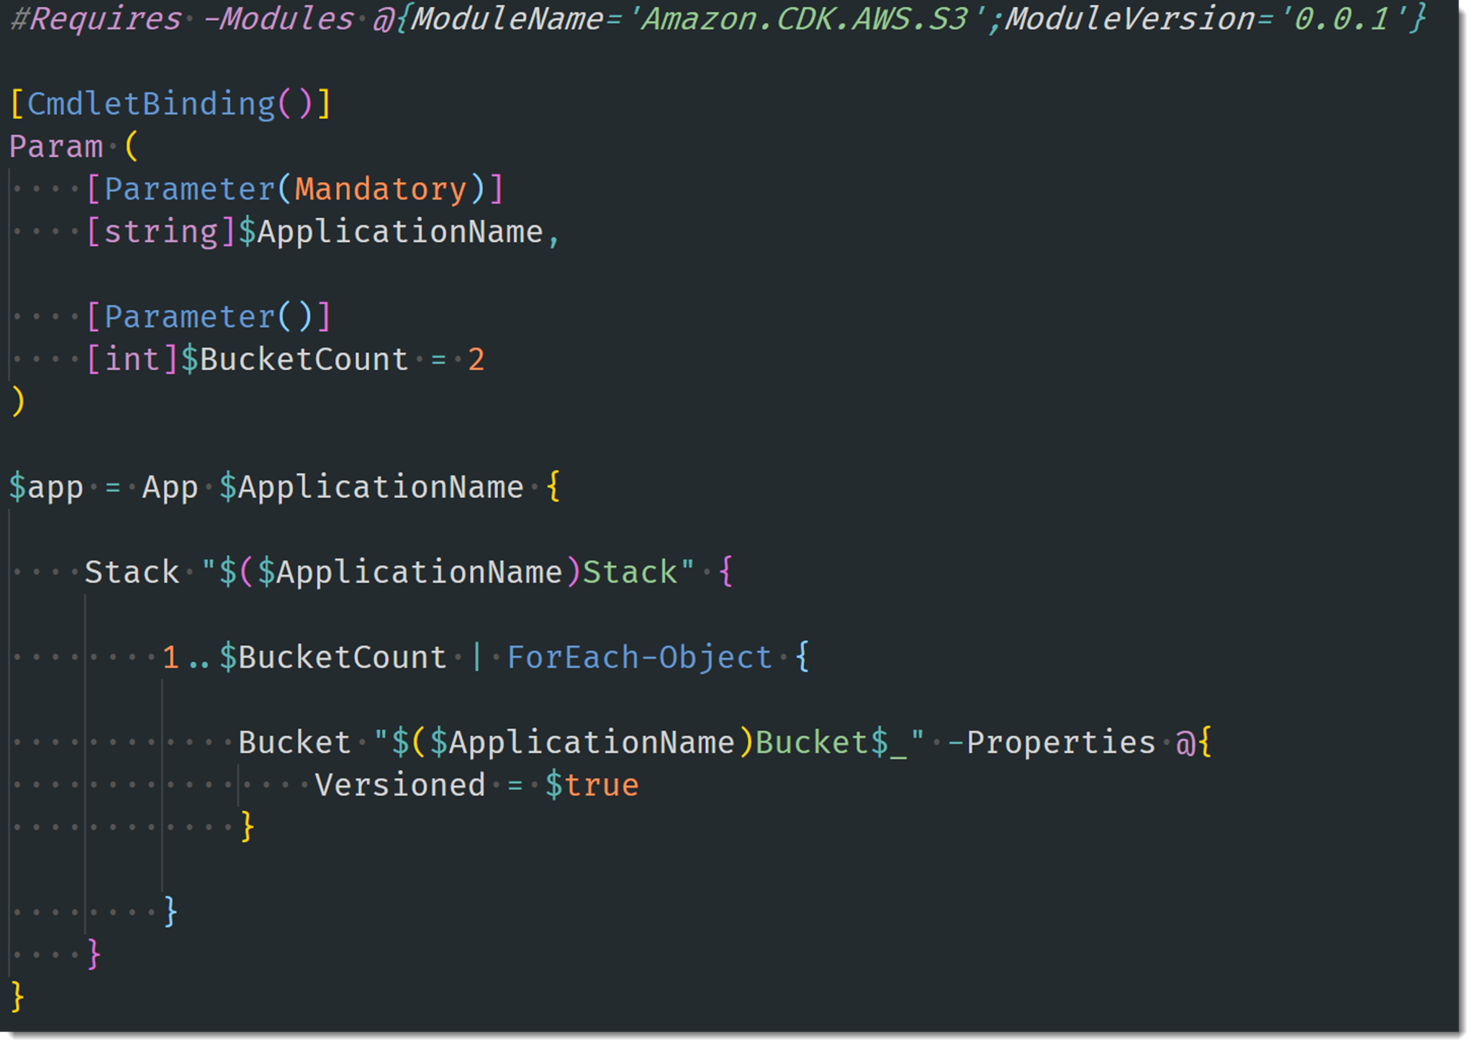
A possible PowerShell DSL for the CDK
This example creates a number of Amazon S3 buckets using the App, Stack and Bucket constructs. Disclaimer – proof of concept only, not yet publicly released!

Slide 24
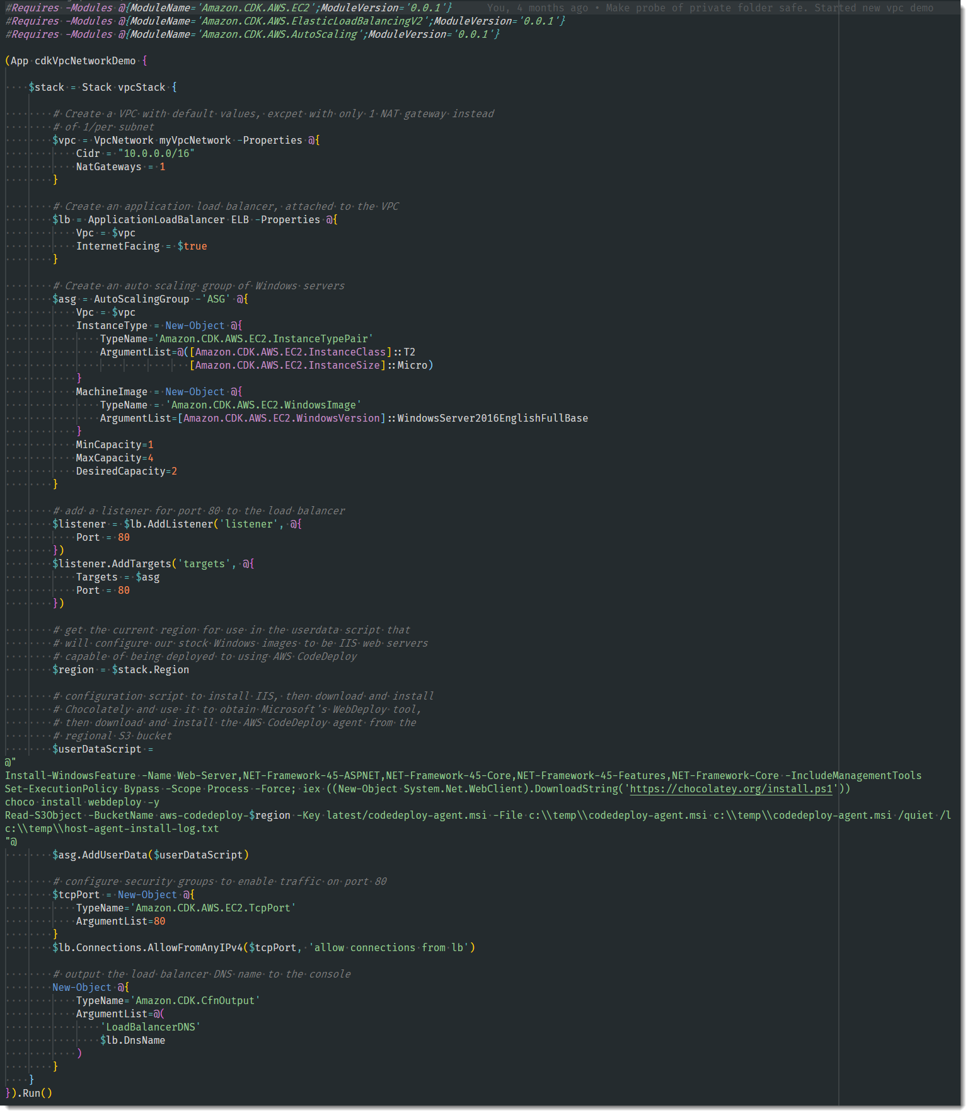
A possible VPC & IIS Web Server Fleet demo 1 example
This example shows the code from demo 1 (300+ lines of imperative code) translated to a possible DSL implementation. It uses a variety of low and higher level CDK constructs to build a VPC with load balancer and configure the fleet of IIS web servers running in the VPC. Disclaimer – proof of concept only, not yet publicly released!

Slide 25
Session recap
Getting started with the AWS Tools for PowerShell
Run, don’t walk, to get the new preview and give feedback ☺
Using PowerShell script to build and configure AWS resources
Using PowerShell and AWS Systems Manager
Writing and using PowerShell-based ‘documents’ with Run Command
Using Session Manager
Using Serverless PowerShell with AWS Lambda to monitor logs
Sneak peek at the (unreleased) PowerShell CDK proof-of-concept

Slide 26
Useful links
(Original) AWS modules on PowerShell Gallery
https://www.powershellgallery.com/packages/AWSPowerShell/
https://www.powershellgallery.com/packages/AWSPowerShell.NetCore/
New per-service modules: AWS.Tools.servicename
See blog post: https://aws.amazon.com/blogs/aws/preview-release-of-the-new-aws-tools-for-powershell/
AWS Tools for PowerShell Reference
https://docs.aws.amazon.com/powershell/latest/reference/
.NET/PowerShell homepage on AWS
https://aws.amazon.com/developer/language/net/
AWS Developer Blog articles on PowerShell
https://aws.amazon.com/blogs/developer/category/programing-language/powershell/

Slide 27
Thank you!
Twitter: @bellevuesteve

